Slide 1
Excercise
Y.-H. Song(RISP,IBS)
2017.July.05 The 2nd RISP Intensive Program on Rare Isotope Physics

Slide 2
Question on homeworks
Please have some time to work on the homeworks.
If you have a question, please ask.

Slide 3
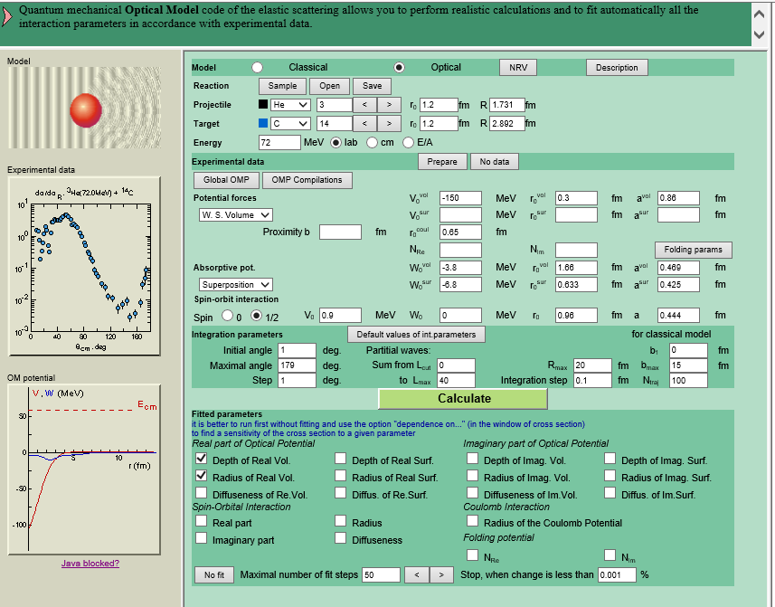
Elastic scattering (Optical Model)

Slide 4
Optical model calculation
Choose any experimental data of proton-elastic scattering in NNDC
https://www.nndc.bnl.gov/exfor/cinda.htm
(1) choose your target and energy (~ 5-70 MeV)
(2) prepare experimental data
(3) Find optical potential parameters to fit the experimental data
(4) Compare with Global optical potential results
(5) check the effects of various parameters

Slide 5
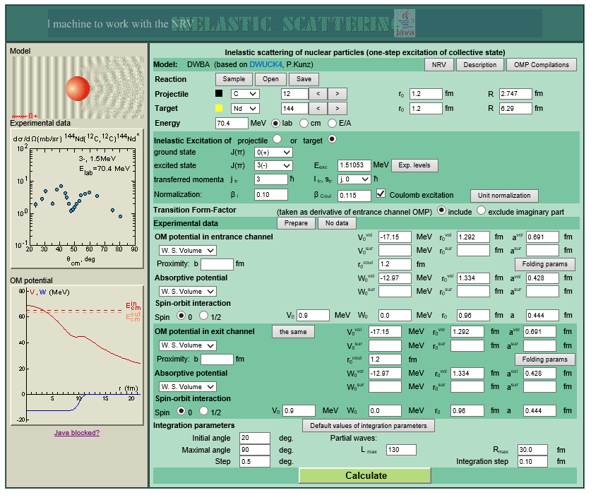
Inelastic scattering (Rotational Model)

Slide 6
Inelastic scattering(Rotor Model)
Try to reproduce the results in
M. YASUE et.al., Nuclear Physics A394 (1983) 29-38
For alpha+12C inelastic scattering at 65 MeV.

Slide 7
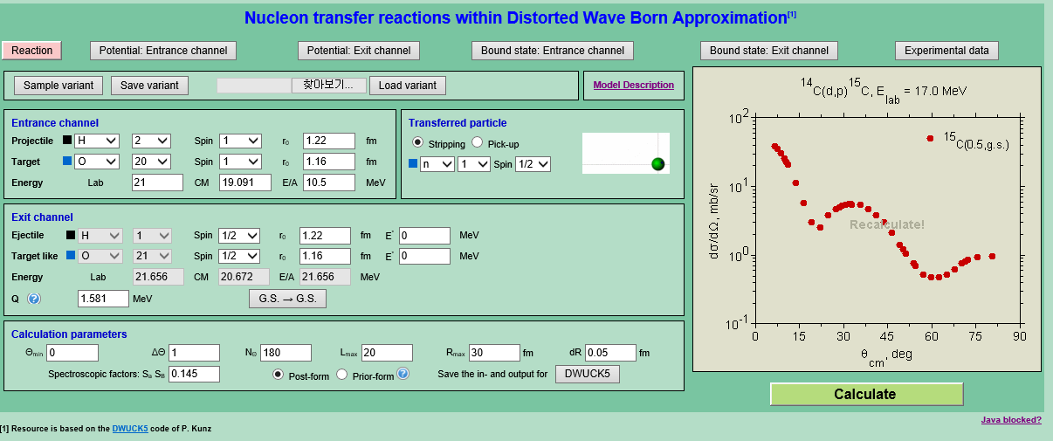
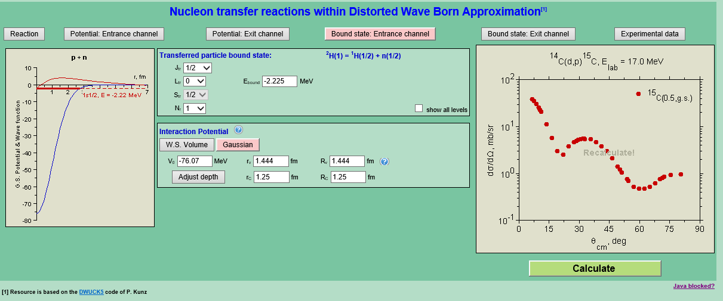

Slide 8
Transfer reaction calculation
Try to reproduce the result for
67Zn(d,p)68Zn* for 1st excited state
PHYSICAL REVIEW C VOLUME 31, 1691, NUMBER 5(1981)
Find the experimental data from EXFOR
Try to analyze/reproduce the results in the paper

